Slide 1

Introuducing products of Attar-Electric Company
For more GUIDANCE and buy our products
Contact us
INFO@ATTARELECTRIC.COM
+985143522201

Slide 2
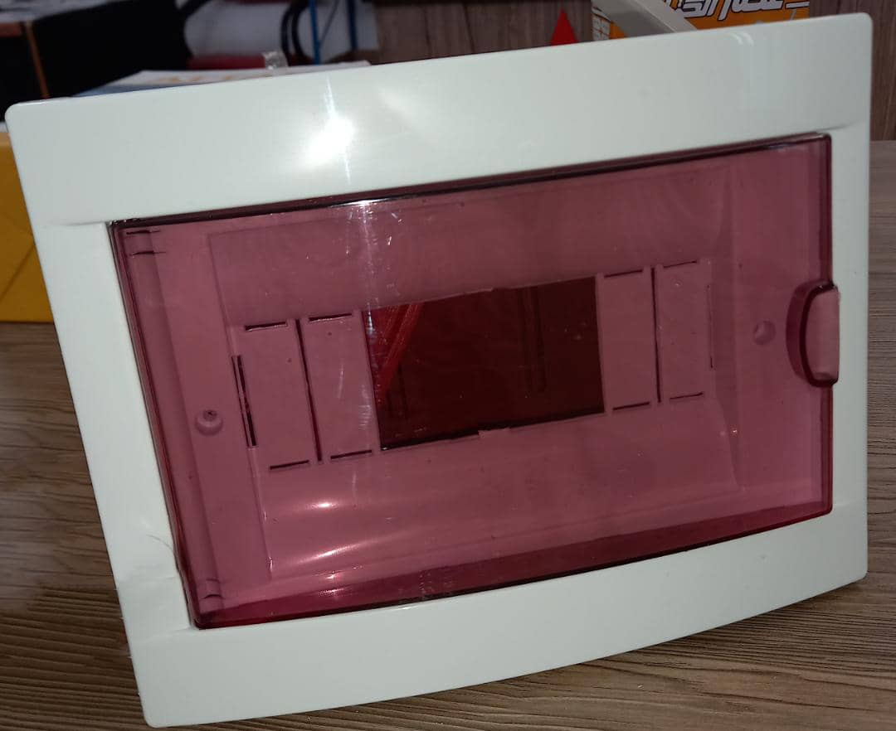
Flush mounted case
Item code:BO
Here we have types of Flush Mounted cases are ready to use ,How many do you want?you can use our discount.we make the best products in Middle East.
Item code:BO2
Description:2Fuse
Price:unknown

Slide 3
Flush mounted case item code:BO
Item code :BO4
Description:4 fuse
Price:unknown

Slide 4
Flush mounted case item code:BO
Item code:BO6
Description:6fuse
Price:1.2$

Slide 5
Flush mounted case item code:BO
Item code:BO8
Description:8fuse
Price:1.76$

Slide 6
Flush mounted case item code:BO
Item code:BO12
Description:12 fuse
Price:unknown

Slide 7
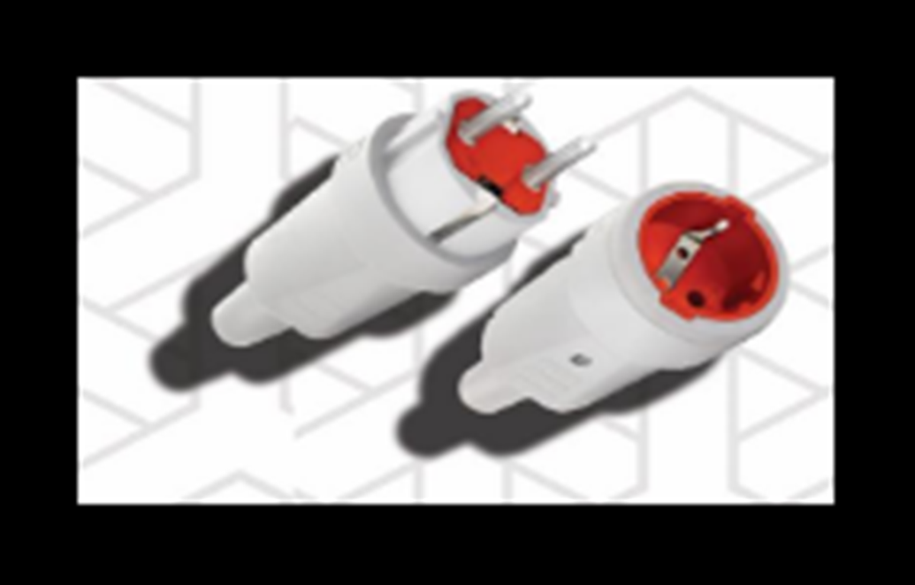
Household Rewireable Plug item code:D2
Quality is not coincidence ,you can feel it.
Item code:D2
Description:30Amp
Price:38C

Slide 8
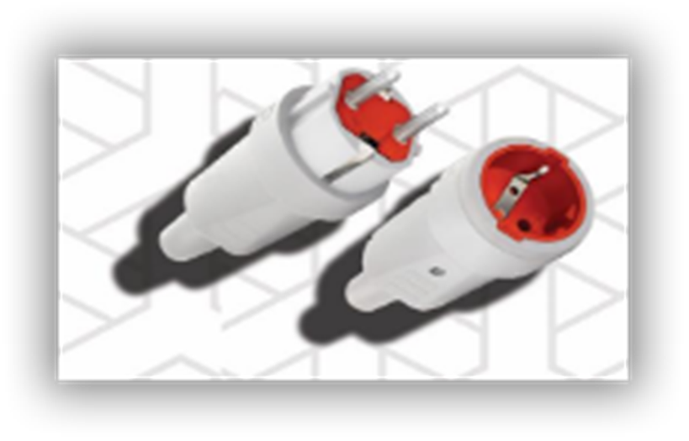
Household Rewireable Socket item code:D2
Item code:DO2
Description:30Amp
Price:38C

Slide 9
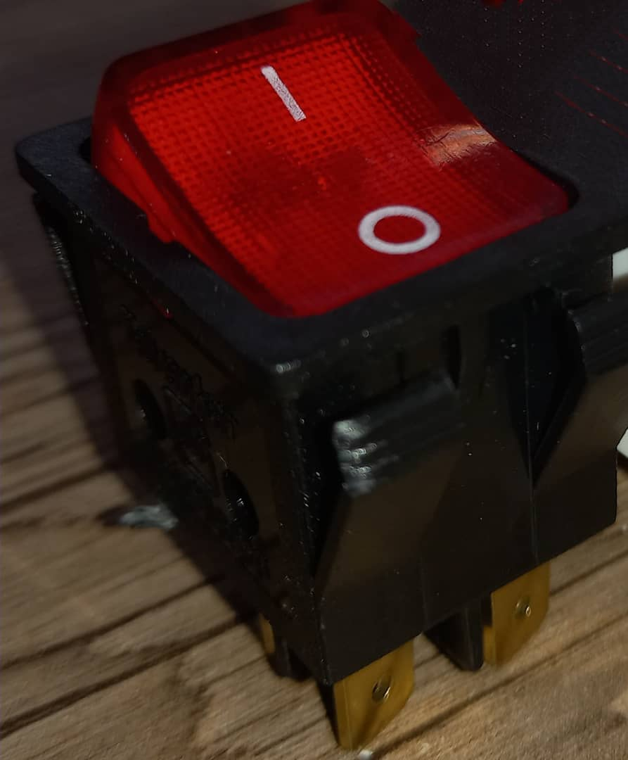
Two pole switch with one actuator knob item code:KO
Item code:KO1
Description:1 pole & 10Amp
Price:32C

Slide 10
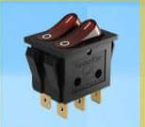
Two pole switch with TWO actuator knob item code:KO
Item code:KO2
Description:2pole&10Amp
Price:61C

Slide 11
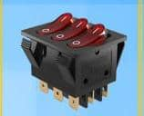
Two pole switch with three actuator knob item code:KO
Item code:KO3
Description:3pole&10Amp
Price:71C

Slide 12
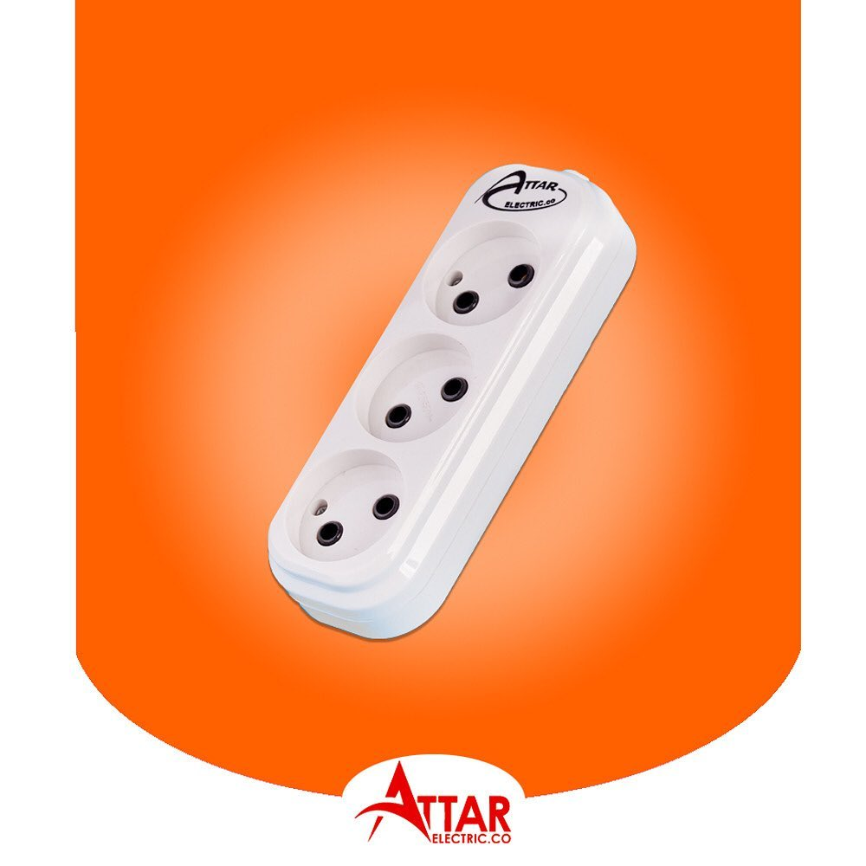
Attar 3 gang group socket item code:SO
Our special unique products are variety of Gang Group Sockets ,come visit us you can see better things that you won’t imagine.
Item code:SO3
Description:16Amp-wireless-5m wire-2m wire
Price:
Wireless: 1.16$
With 2m wire:1.67 $
With 5 m wire :2.51$

Slide 13
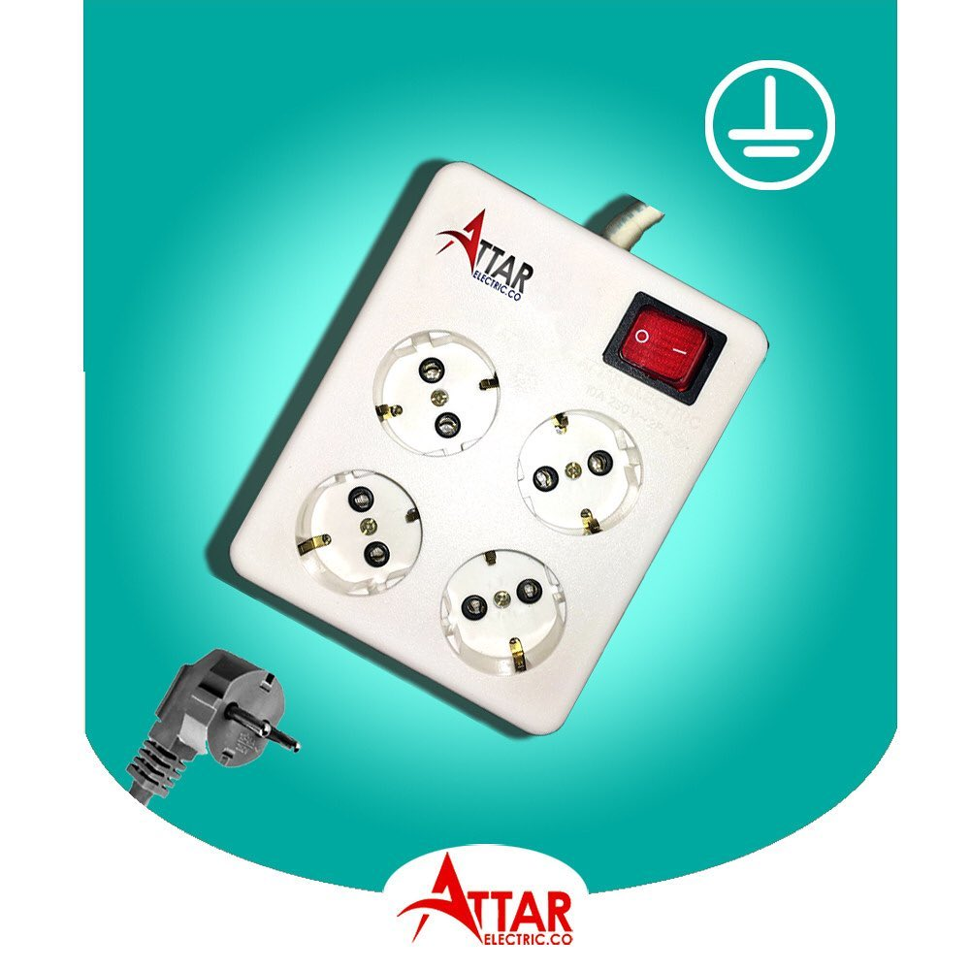
Attar 4 gang group socket+E item code:SO
Item code:SO4
Description:16Amp-2m wire-5m wire
Price:
With 2m wire:5.2$
With 5m wire: 5.68$

Slide 14
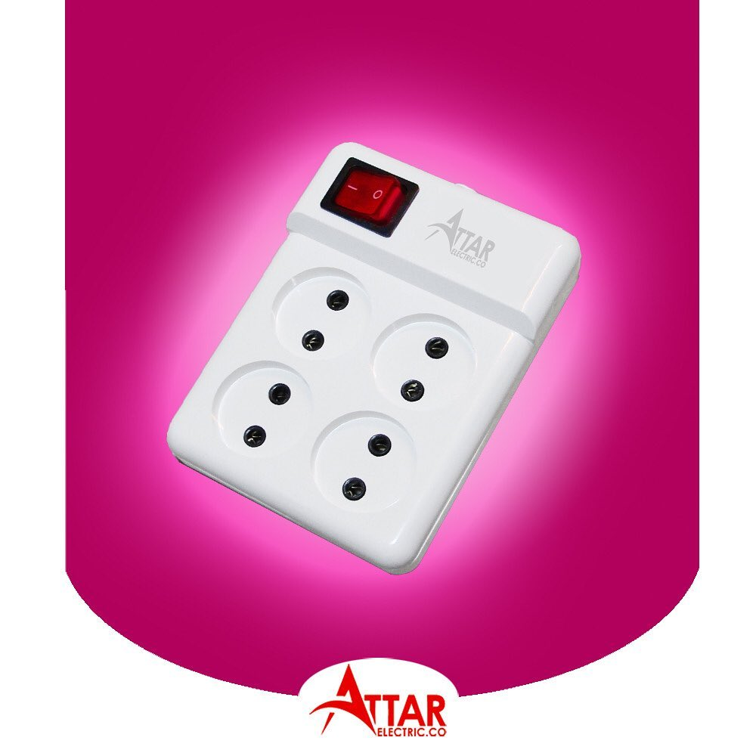
Attar 4 gang group socket item code:S
Item code:S14
Description:16Amp-wireless-5m wire-2m wire
Price
Wireless: 1.69$
With2m wire:2.4$
With 5m wire :3.26$

Slide 15
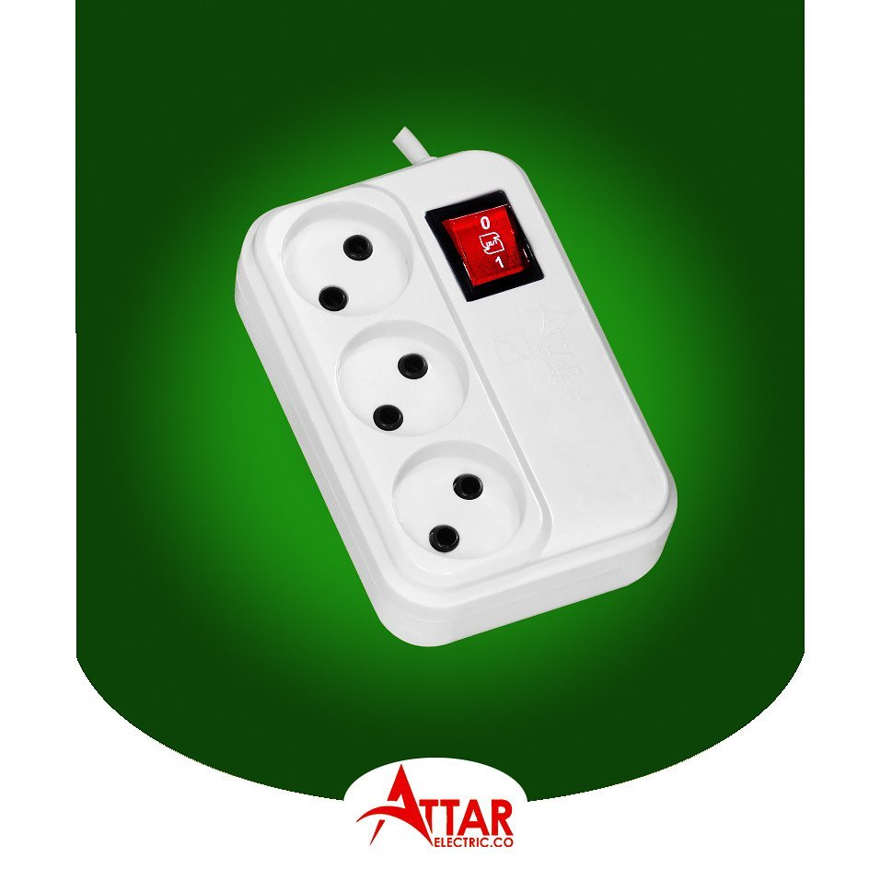
Novin gang group socket item code:S
Item code:s13
Description:16Amp-wireless-5m wire-2m wire
Price:
Wireless:1.31$
With 2m wire:1.94$
With 5m wire: 2.71$

Slide 16
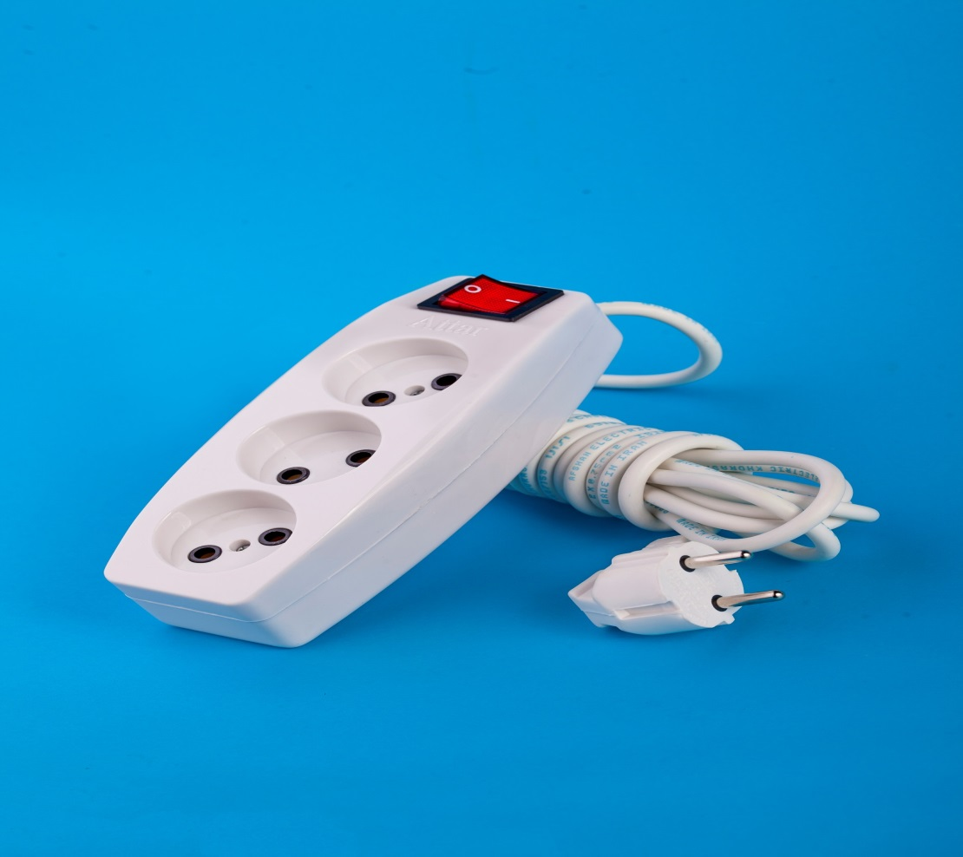
Simorgh 3 gang group socket
Item code:s23
Description:16Amp-wireless-5m wire-2m wire
Price:
Wireless:1.29$
With 2m wire:1.84$
With 5m wire:2.57$

Slide 17
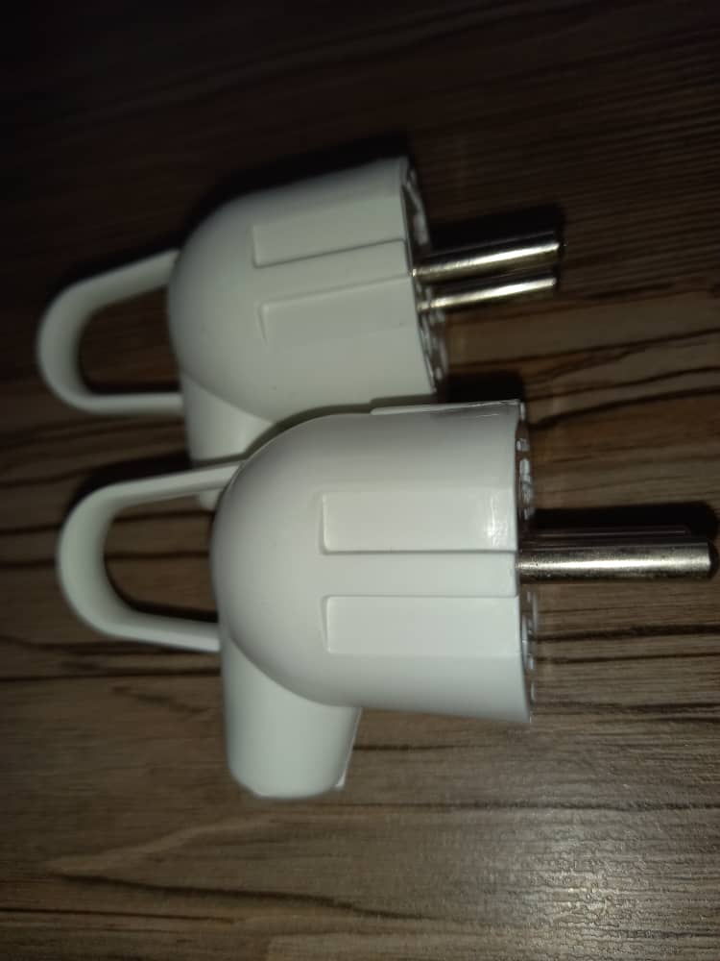
Plugs item code:D
Item code:D1
Description:16Amp
Price:21C

Slide 18
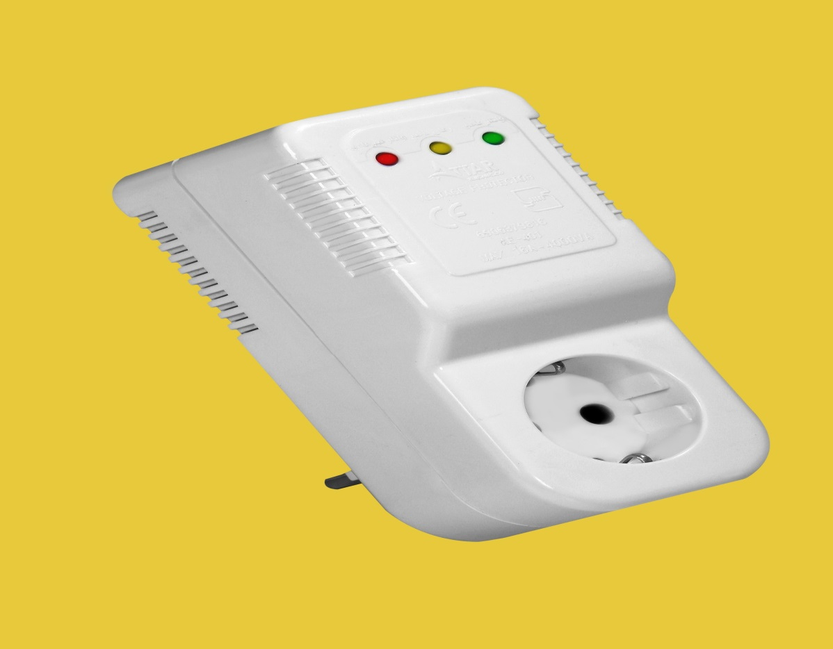
Voltage protector item code:Po1c
Our Voltage protector can guarantee that your air conditioner works properly forever.
Item code:PO1C
Description:16Amp
Price:4.77$

Slide 19
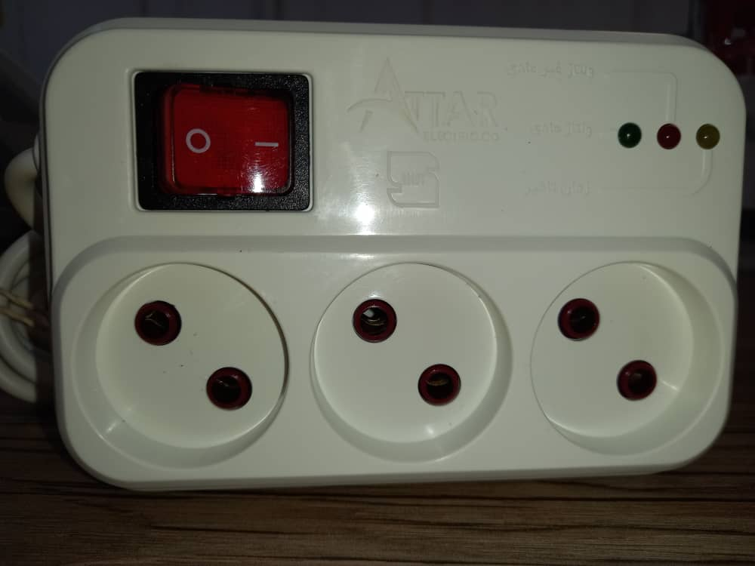
Voltage protector item code:PO3R
We have a best products for your health and safety of your refrigerator.
Item code:PO3R
Description:For refrigrator 5 min-
2m wire-5m wire
Price:
With 2m wire:4.24$
With 5m wire:4.48$

Slide 20
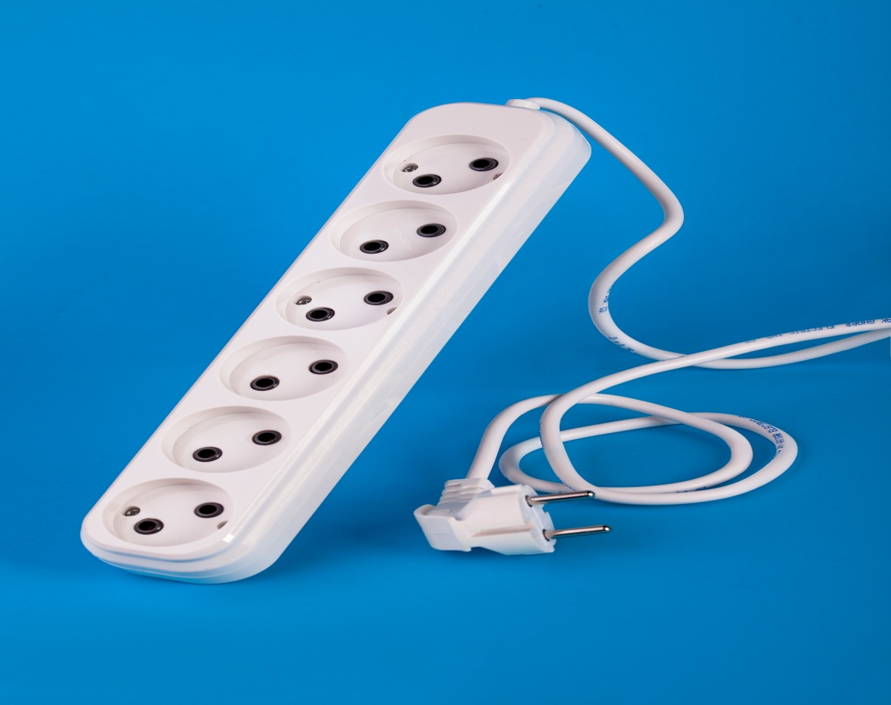
Attar 6 gang group socket item code:SO
Item code:SO6
Description:For refrigrator 5 min-wireless-5m wire-2m wire
Price:
Wireless :1.6$
With 2m wire:2.13$
With 5m wire:2.85$

Slide 21
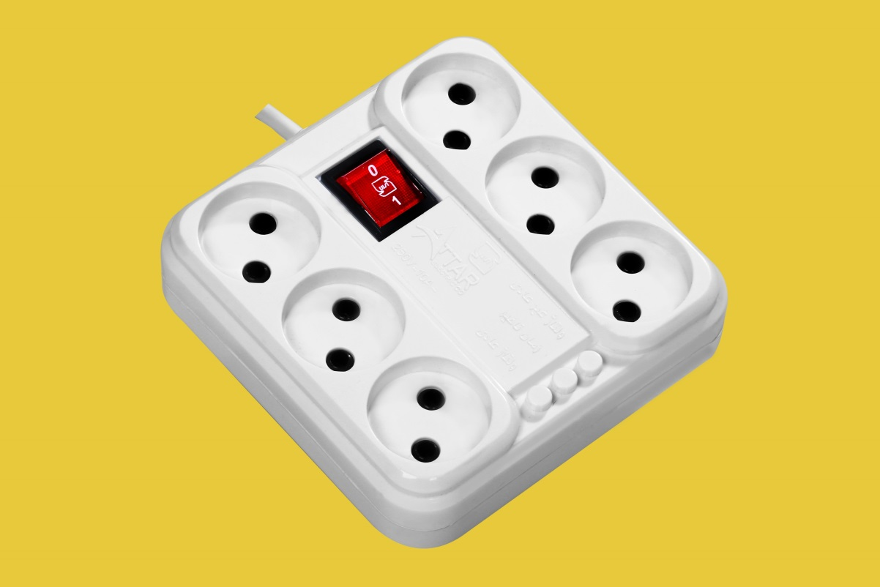
Novin gang group socket item code:S
Item code:S16
Description:16amp-wireless-5m wire-2m wire
Price:
Wireless :1.97$
With 2m wire:2.56$
With 5m wire:3.2$

Slide 22

Attar Electric
Worthy of globalization

